Slide 1
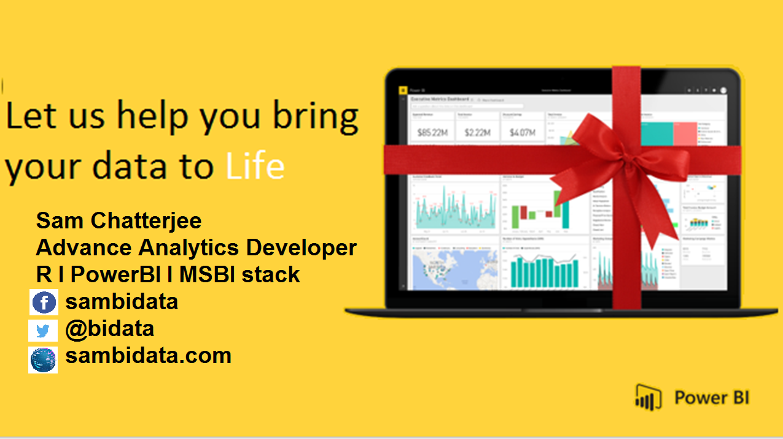

Slide 2






M

Slide 3
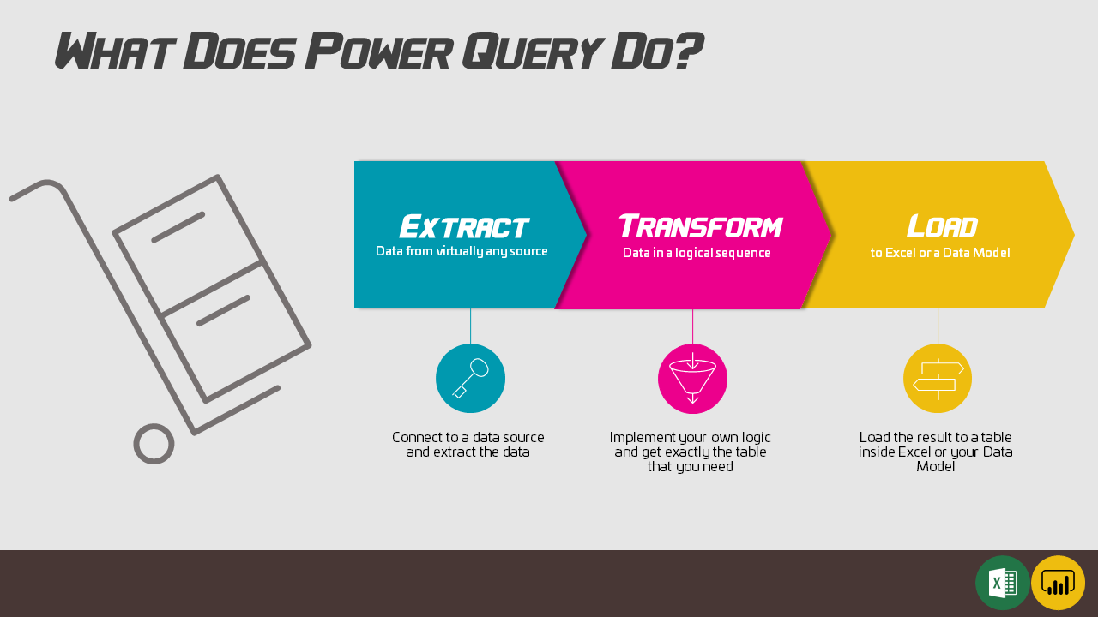

Slide 4
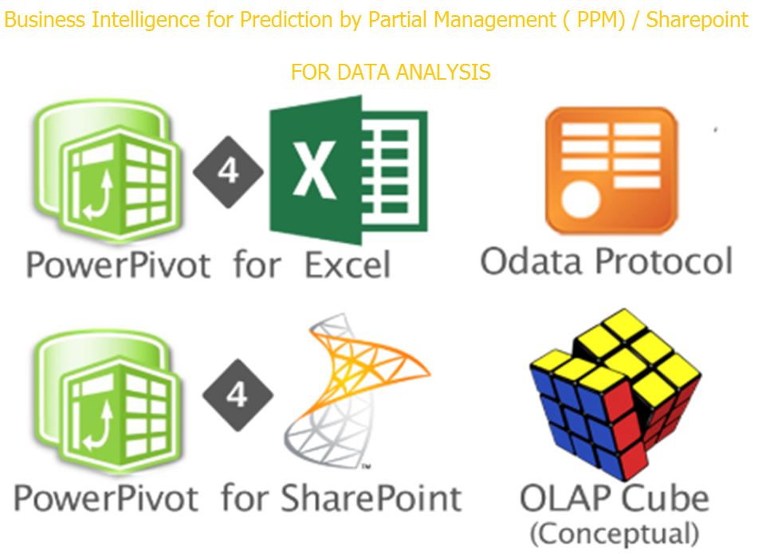

Slide 5







Slide 6
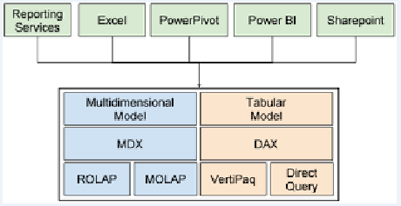

Slide 7
VS
M
DAX

Slide 8
DAX LANGUAGE
Problem solvers
Tabular Model
Help to solve any problem
Powerpivot tables
Tables with DAX
Love Columns, Hate Rows
6
4
Data Modelling
PowerBI Model
2
SSAS
Measures and Calculated Columns
Works with PowerBI model
Analysis server, tabular model
5
1
3

Slide 9
M Language
Stands for Data Mashup
Build Custom Data Connectors
Scripting Language
Like New Data Sources
Create function Libraries
Runs through advanced editor
Data Mashup
Through scripts
DATA Transformation Engine
9
7
Transform the data through query
10
8

Slide 10
M- Function
Why We need M
1
M Stands for Data Mashup.
Functional Language depends on functions only.
1
How we use M
2
- Cleaning and Transforming the data.
Understanding the User Interface
2
What M will help
3
Custom data Connectors.
SSAS partitions
3

Slide 11

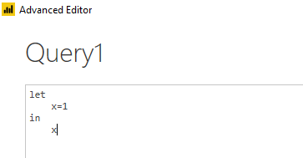

Is very simple:
It always has two blocks of Expression
Let -- means let take any value or definiton of all variables.
In -- Output! Yes everything you put in this block will be the output of your query
Case Sensitive X=1 is not equal to x=1

Slide 12
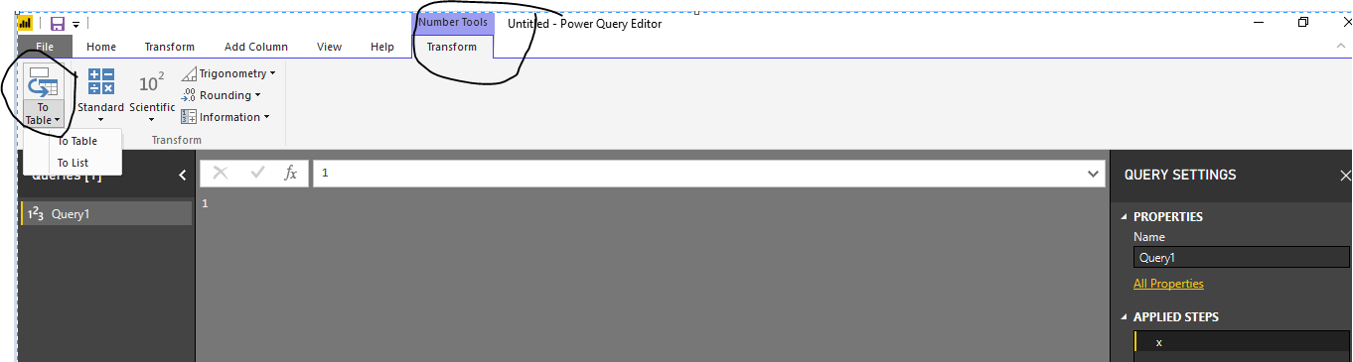
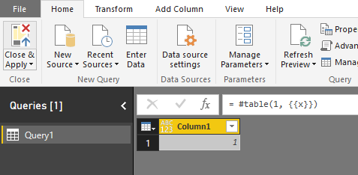
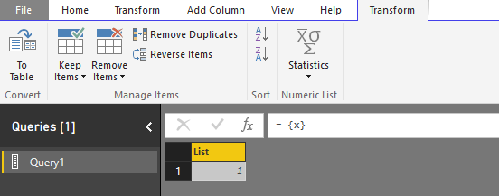
This gives an automatic query transfer to the query settings and the queries. Data Transformation occurs as without any problem
This gives an auto query transformation to the query editor window. Look closely to the table and the list

Slide 13
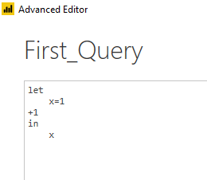
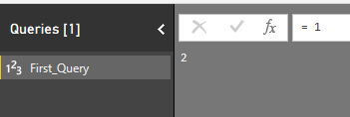
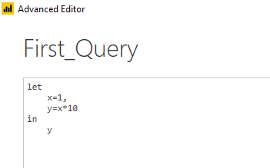
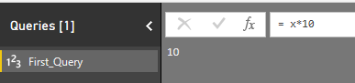
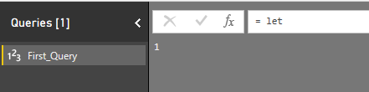
End of the Line
Lines of codes in M continues if you don’t put the end of the line character.
If you want to put an end for a line use comma(,).

Slide 14
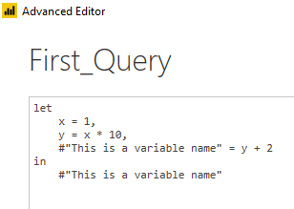
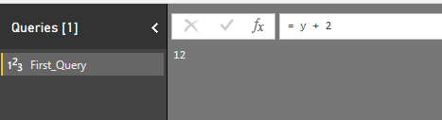
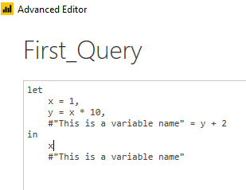
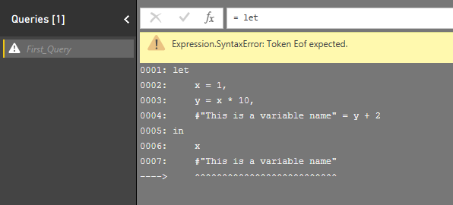
Variable Names
Name of variables can be all one word, like Source.
It can has spaces in it.
In case that you have some characters such as space, then you need to put the name inside double quote (“) and
put a hashtag at the beginning of it(#). something similar to:

Slide 15
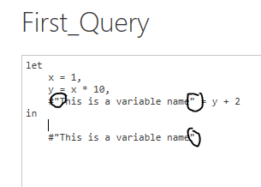
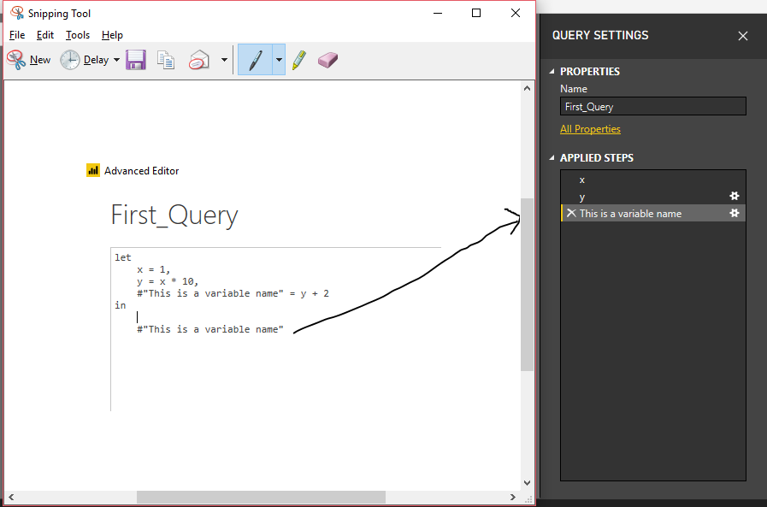
Escape Characters
Escape characters
Step By Step Coding
Power Query is a step by step transformation. Every transformation usually happens in a step. While you are writing the code, you can also notice that in the right hand side, you will see every variable forms a step.
The last variable always specifies IN section

Slide 16
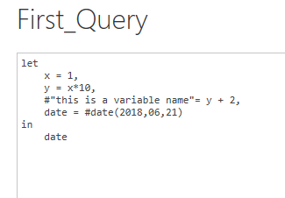
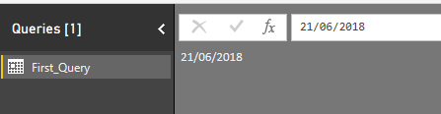
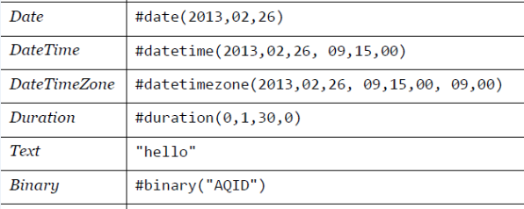
LITERALS
There are different ways of defining every literal in Power Query. For example, if you want to define a date variable, here is how to do it;

Slide 17
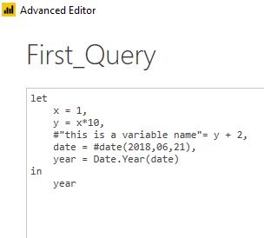
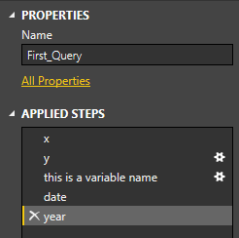
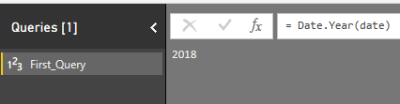
Function Call
M is a functional language,
Data mashup using queries.
doing almost everything you need to call a function for it.
Functions can be easily called with name of the function and specifying parameters for it.

Slide 18
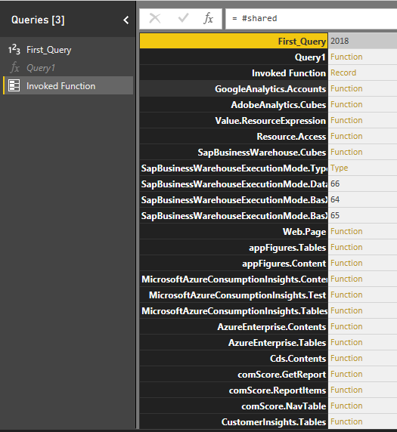
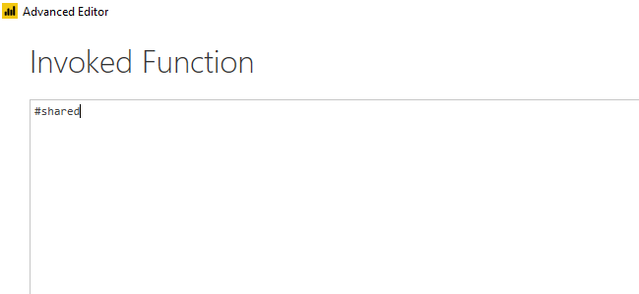
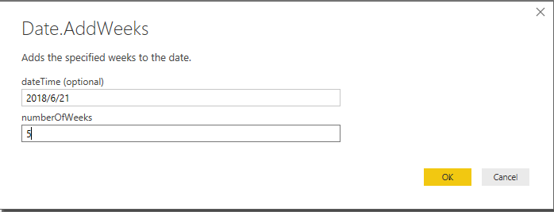
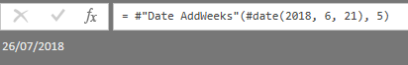
#functions in M
#shared is the keyword where you can get all the functions load

Slide 19
Say you have a table that looks like this
OrderID | CustomerID | Item | Price
1 | 1 | Working bag | 22
2 | 1 | 1 kilo lux | 1
3 | 2 | figured pack | 30
And, you want to capitalize each word in the Item column to produce the following table:
OrderID | CustomerID | Item | Price
1 | 1 | Working Bag | 22
2 | 1 | 1 Kilo Lux | 1
3 | 2 | Figured Pack | 30

Slide 20
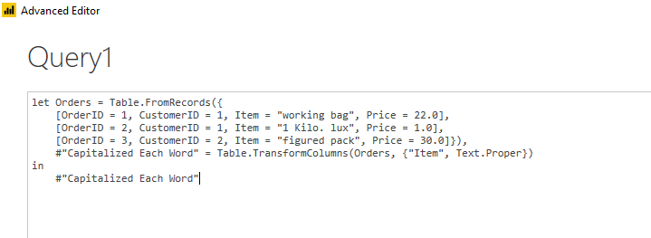
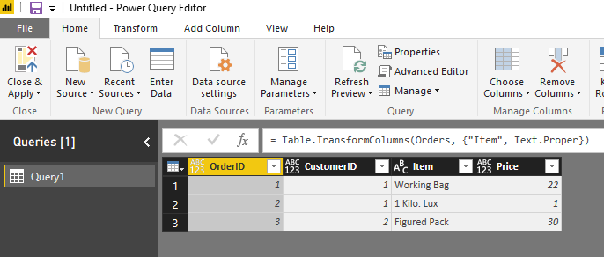
let Orders = Table.FromRecords({
[OrderID = 1, CustomerID = 1, Item = "working bag", Price = 22.0],
[OrderID = 2, CustomerID = 1, Item = "1 Kilo. lux", Price = 1.0],
[OrderID = 3, CustomerID = 2, Item = "figured pack", Price = 30.0]}),
#"Capitalized Each Word" = Table.TransformColumns(Orders, {"Item", Text.Proper})
in
#"Capitalized Each Word"

Slide 21
Let’s review each formula step.
Orders – Create a [Table](#_Table_value) with data for Orders.
#"Capitalized Each Word" – To capitalize each word, you use Table.TransformColumns().
in #"Capitalized Each Word" – Output the table with each word capitalized.

Slide 22
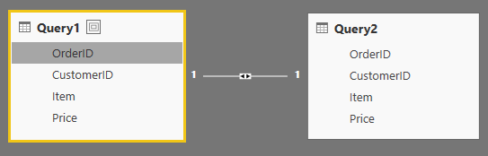
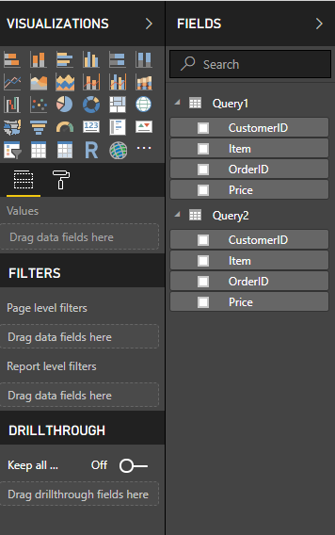

Slide 23
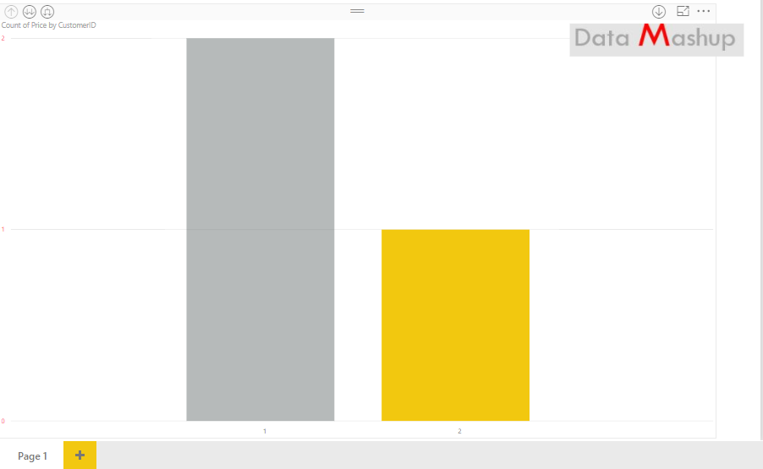

Slide 24
20%
GRIDS
LINES
SIZE
SHAPES
CONSISTENCY
ALIGNMENT
SPACING
COLOR
SIMPLICITY
BALANCE
BACKGROUND
CONTRAST

Slide 25
MEASURES
RELATIONSHIPS
DAX
DATA SOURCES
EDIT QUERIES
APPEND
TRANSPOSE
M
DRILL DOWN
UNPIVOT
COMBINE BINARIES
FORMULAS
MULTIDIMENSIONAL TABLES
HIERARCHY
SPLIT COLUMNS
MODELING
SORT BY
AGGREGATE
MERGE
EXTRACT
FILTERS
PIVOT
REPLACE
REMOVE DUPLICATES
EXPAND
SUMMARIZATION

Slide 26
WORKING,
CLEANING
ENHANCING
80%
AND
THE
DATA

Slide 27
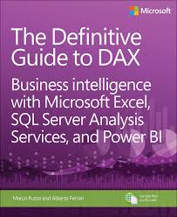

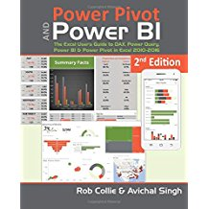

Resources
Get Power BI (Free) http://tinyurl.com/hj5hdg6
Power BI Jump Start http://bit.ly/1ktON16
Power BI Getting Started http://bit.ly/1FF88KA
Power BI Team Blog http://bit.ly/1vwbTLG
Power BI Channel 9 http://bit.ly/1a9Q0gv
Power BI https://powerbi.microsoft.com

Slide 28
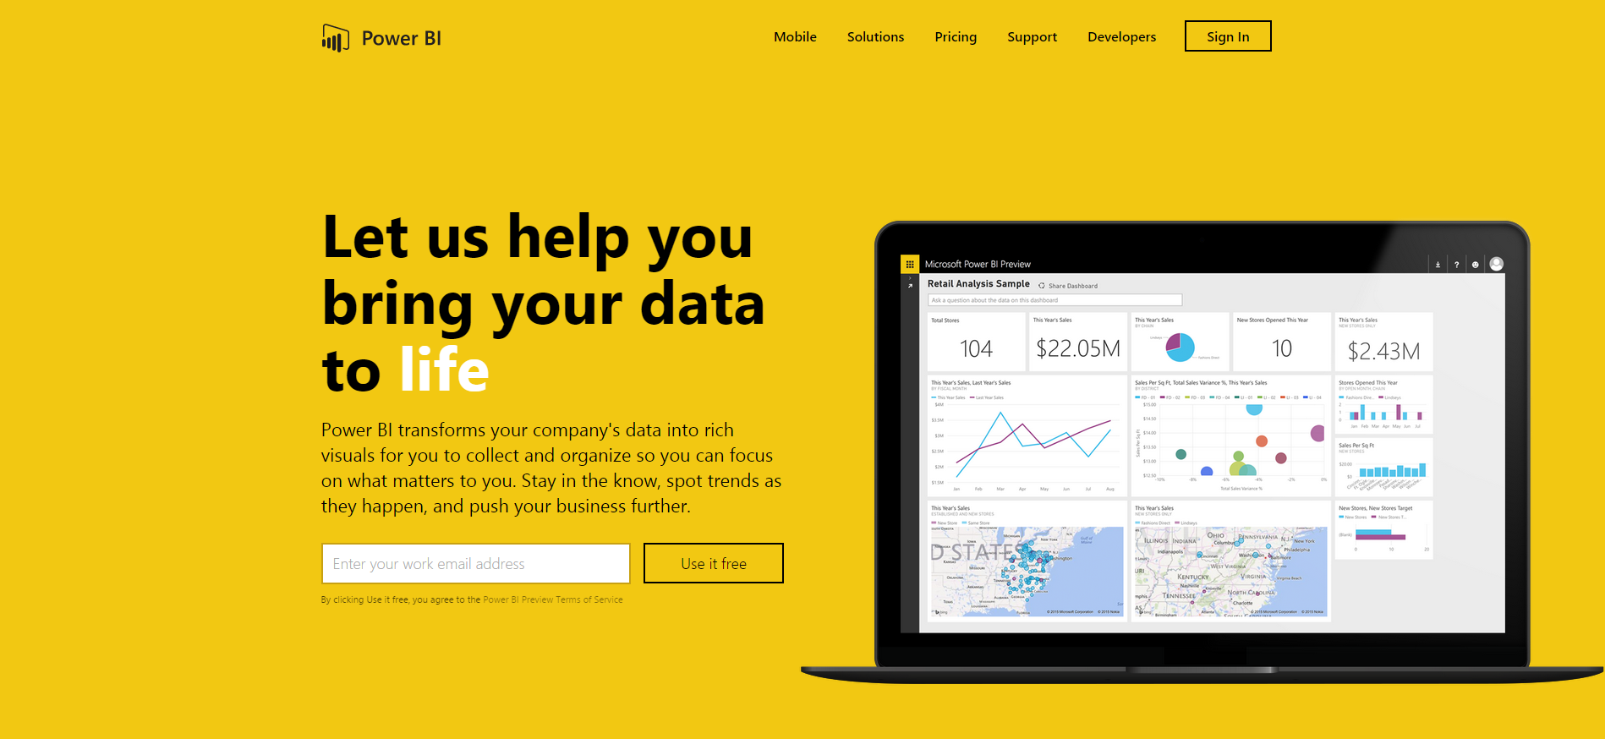
Thankyou for Coming to PowerBI
Sign up for a free Preview account
Take the Power BI Tour
Notes:
Thanks for taking the time to walk through the main capabilities of Power BI.
If you’re ready to start exploring what Power BI can do for you and your organization, please visit powerbi.com.

